Slide 1
AI ENABLED RESUME ANALYZER
Where Your Search Ends.

Slide 2
Contents
01
02
03
04
Introduction
Advantages & Features of Proposed Tool
Disadvantage of Current System
Technologies Used
05
06
Requirements
Limitations of Proposed Tool
07
08
Conclusion
Reference

Slide 3
01
INTRODUCTION

Slide 4
The Main Objective of this tool is to analyze Applicant’s Resume Using Resume Parser Technique and Some Algorithm.
It Can be Used by any Organizations (Company/College/Individual User) that handle resume screening process.
The tool keep’s a track of all records into database for further admin side analysis.
Provides Tips and Recommendations based on their resume.

Slide 5
Advantages & Features of Proposed Tool
02

Slide 6
Tracks and Sort Resume Based on Job Roles.
Fast, Safe, Real-time Predictions.
More Efficient Review Overall.
Applicant’s Side
Applicant’s can upload their resume.
Using Parsing technique, it will fetch
Basic Info
Level of Expertise
Skills
Keys (for resume scoring)
Using Some Algorithm, it will recommend
Skills that can be added
Job role you are looking for
Your Expertise Level
Course & Certificate recommendations
Resume Tips & Ideas
Resume Overall Score
Interview & Resume Tip (YouTube Videos)

Slide 7
Admin Side Get’s all the applicant data into a tabular format. Download data into csv file. Pie Chart for Predicted Field/roles according to skills. Pie Chart of user’s experience level. Total Number of applicants have uploaded their resumes. Monthly Timeline. Activity Maps Most Busy Day Most Busy Month

Slide 8
Disadvantage of Current System i.e. (Manual Resume Screening)
03

Slide 9
Time Consuming.
It is challenging task to handle resume manually.
Requires individual review of each resume from hiring managers
The same amount of time and effort is often expelled for candidates who are qualified as the ones who are.

Slide 10
04
Technologies Used

Slide 11
Frontend
Managed By Streamlit
Backend
Managed By Streamlit
Database
MySQL
Programming Language
Python3
Packages (pip)
Pandas
Base64
Numpy
PyResparser
PdfMiner
Plotly

Slide 12
Requirements
05

Slide 13
A Laptop/Desktop
Connected with Internet and has a browser
Installed MySQL
Single Network Connection
So that other devices can connect through network URL
A Simple Format Resume to test the tool

Slide 14
Limitations of Proposed Tool
06

Slide 15
May not give you accurate result because of different resume formats.

Slide 16
07
Conclusion

Slide 17
A Quick and easy to use Resume Analyzer
That analyze resume data and extract it into machine-readable output
Helps applicants with few recommendations.
And helps automatically store, organize, and analyze resume data to find the best candidate.

Slide 18
References
08

Slide 19
https://www.ijitee.org/wp-content/uploads/papers/v9i7/F4078049620.pdf
https://www.academia.edu/32543544/Resume_Parser_with_Natural_Language_Processing
https://www.rchilli.com/blog/resume-parsing-101/
https://en.wikipedia.org/wiki/R%C3%A9sum%C3%A9_parsing

Slide 20
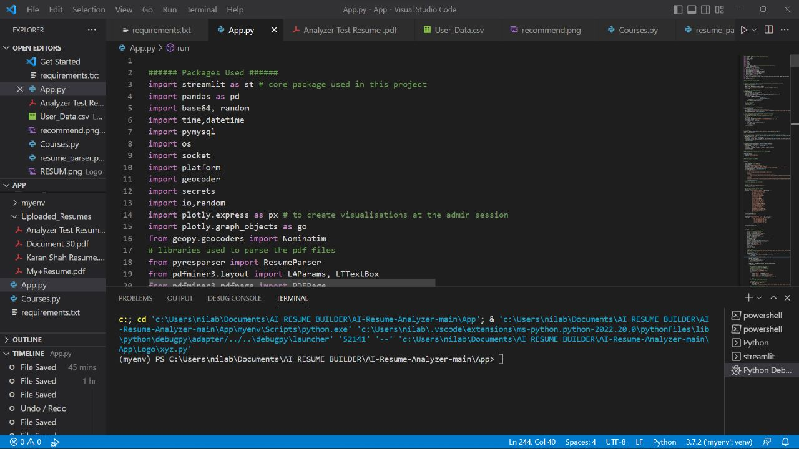

Slide 21
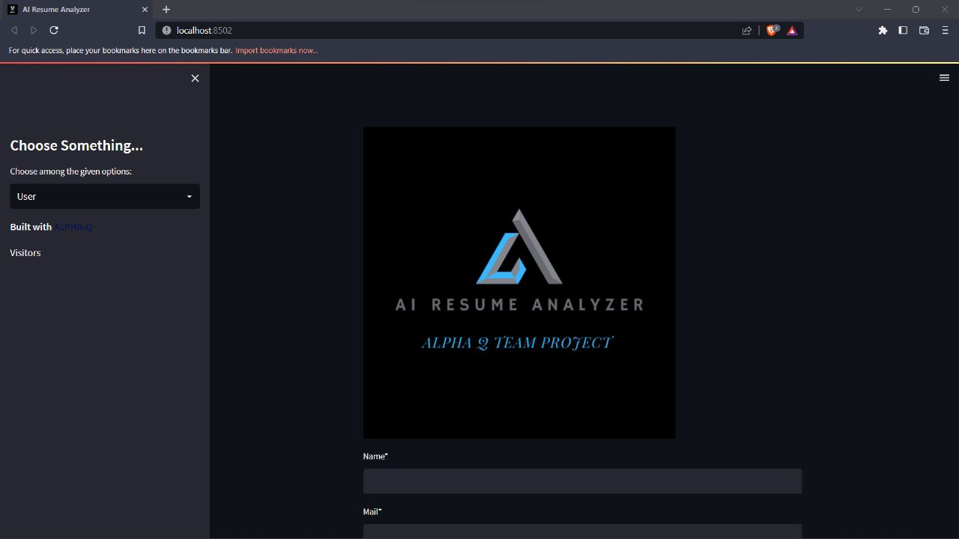

Slide 22
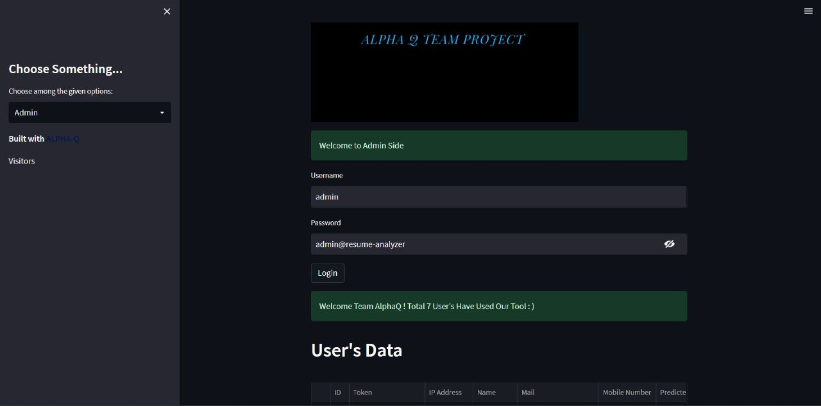

Slide 24
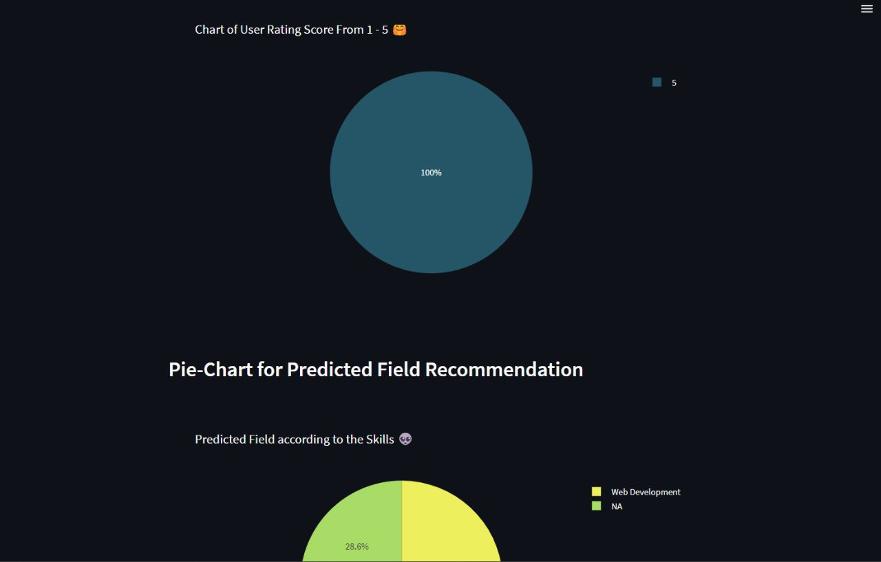

Slide 25
THANK YOU

